Slide 1




WORD-LEVEL PLAGIARISM CHECKER FOR SHORT DOCUMENTS
2520090078 - Hitesh Suthar
2520090136 – Vasudeva
Guide Name - Chandusha kanda

Slide 2
Introduction
  Word-Level Plagiarism Checker is a software system designed to identify copied or duplicated content in short documents.
  It compares the words and phrases of a submitted document with reference or existing text.
  The system performs text extraction and preprocessing to remove unnecessary characters and standardize the content.
  It uses tokenization to divide the document into individual words or meaningful units.
  The system performs word-level comparison to identify matching or similar words and phrases.
  A similarity score is calculated to measure the percentage of matching content.
  It helps users quickly detect possible plagiarism in assignments, reports, articles, and other short documents.
  The system can generate a plagiarism report showing the detected similarities and overall plagiarism percentage.

Slide 3

SOFTWARE REQUIREMENTS
Operating System: Windows
Programming Language: Java
Development Environment: Java IDE
Text Processing: Java-based text processing
Input: Short text documents
Output: Similarity percentage and plagiarism report

Slide 4



HARDWARE REQUIREMENTS
Computer or laptop
Basic processor
Minimum 4 GB RAM
Sufficient storage
Keyboard, mouse, and monitor

Slide 5
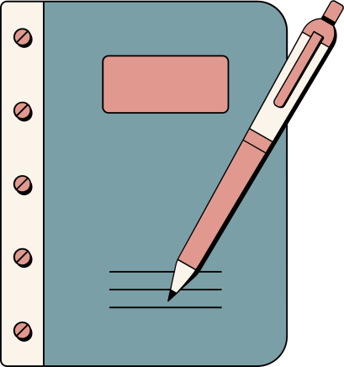
4. METHODOLOGY
  Step 1: Input Document –
  provide the document and reference documents.
  Step 2: Text Extraction – extract text from the documents.
  Step 3: Text Preprocessing – lowercase conversion, punctuation removal, stop-word removal, and tokenization.
  Step 4: Word-Level Comparison – identify matching words, repeated words, and common sequences.
  Step 5: Similarity Calculation – calculate the similarity percentage.
  Step 6: Plagiarism Detection – analyze the similarity score.
  Step 7: Report Generation – generate matched content, score, and plagiarism indication.
  Step 8: Display Results – present the report to the user.

Slide 6

LITERATURE SURVEY
Text Preprocessing: Converts text to lowercase, removes punctuation and stop words, and tokenizes words.
Word Matching: Compares individual words to identify matching content between documents.
Sequence Matching: Identifies common words and consecutive word sequences.
Similarity Measurement: Uses matching content to calculate a similarity percentage.
Plagiarism Report: Displays matched content, similarity score, and possible plagiarism.
Advanced Methods: NLP and Machine Learning can be used in future to detect deeper similarities.

Slide 7
CONCLUSION
Provides a simple method for plagiarism detection.
Finds matching words and phrases.
Calculates similarity percentage.
Generates an understandable plagiarism report.
Reduces manual checking effort.
Can be extended with NLP and Machine Learning in the future.

Slide 8
THANK YOU

